Slide 1

Agenda
Minutes of 2025 Meeting
Matters Arising
Updates from your County Councillor & District Councillors
Annual report from the Parish Council

Slide 2
Annual Parish Council Report: Achievements & Risks
10 March 2026

Slide 3
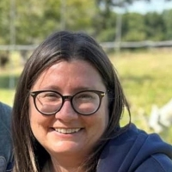
2.Our New Clerk – Vicky Middleton-Head

Slide 4
3.Parish Council Meetings
Full Council – 5 times per year
Planning Committee – 10 times per year
Employment Committee – 2 times a year
Lots of External Meetings

Slide 5
4.Planning Applications
Over the last year we have dealt with 31 new planning applications in the parish- we are a Statutory Consultee:
- Extensions
- Outbuildings
- Caravans
- Trees
- Class Q new housing- permitted development
- Conditions

Slide 6
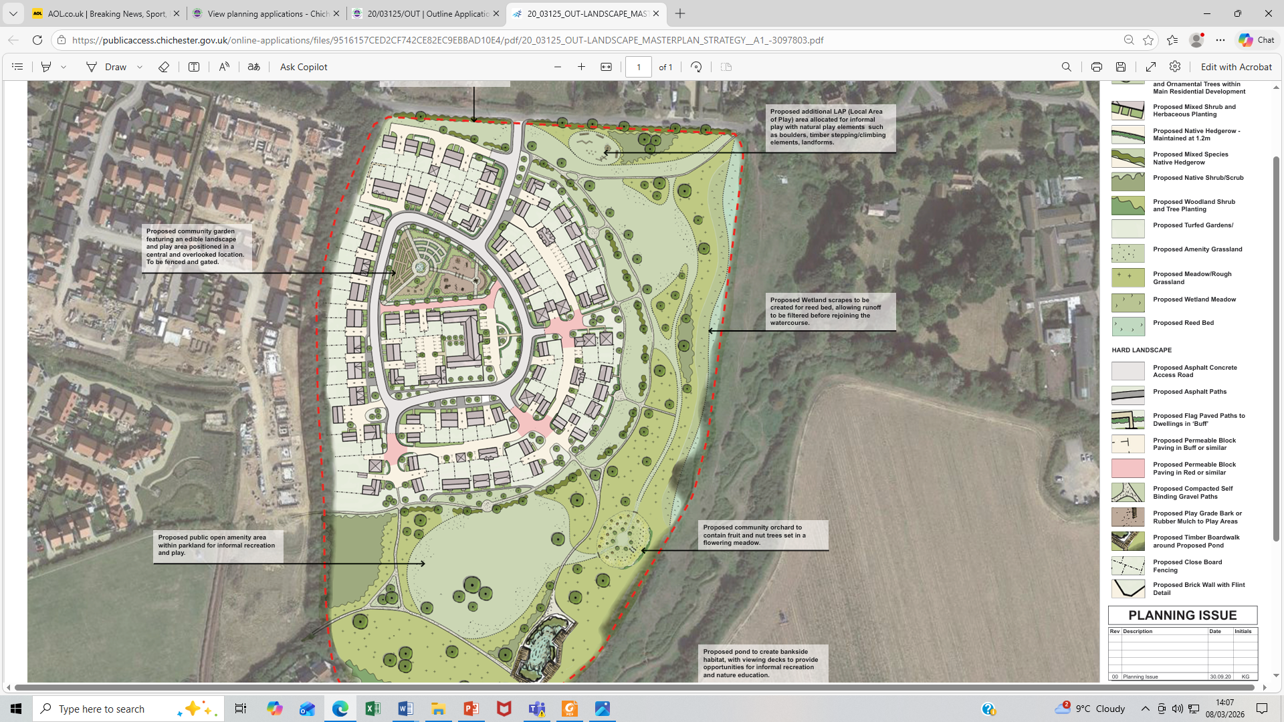
5.Clappers Lane – Illustrative Masterplan

Slide 7
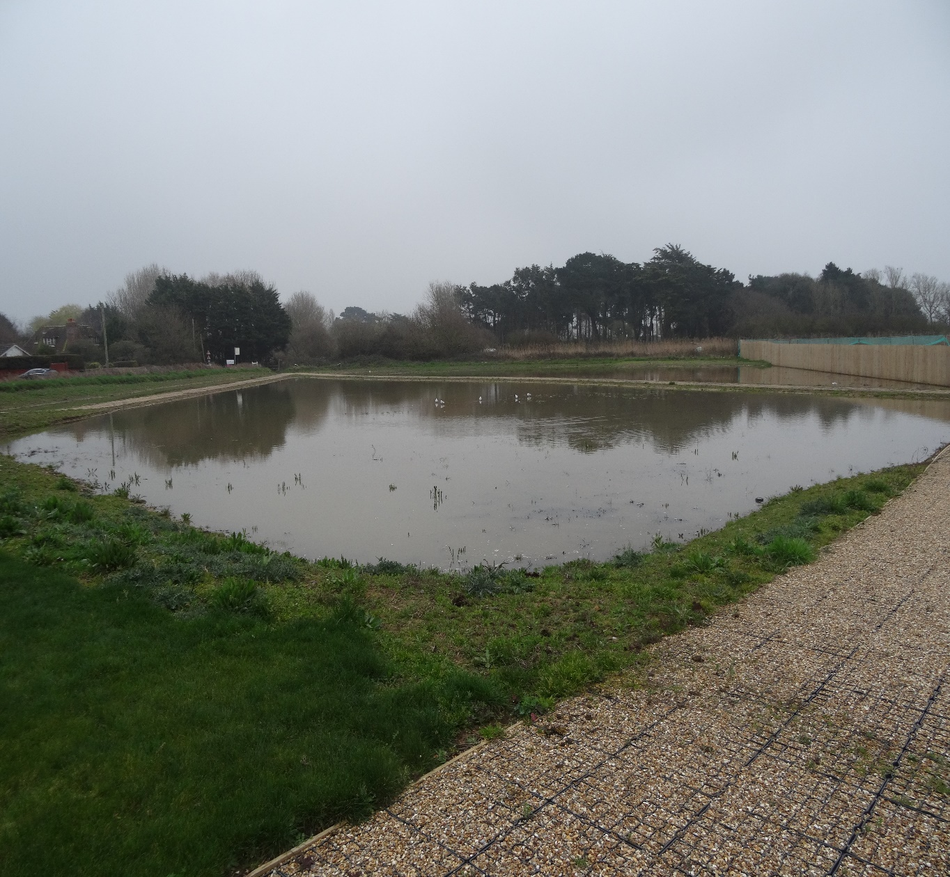
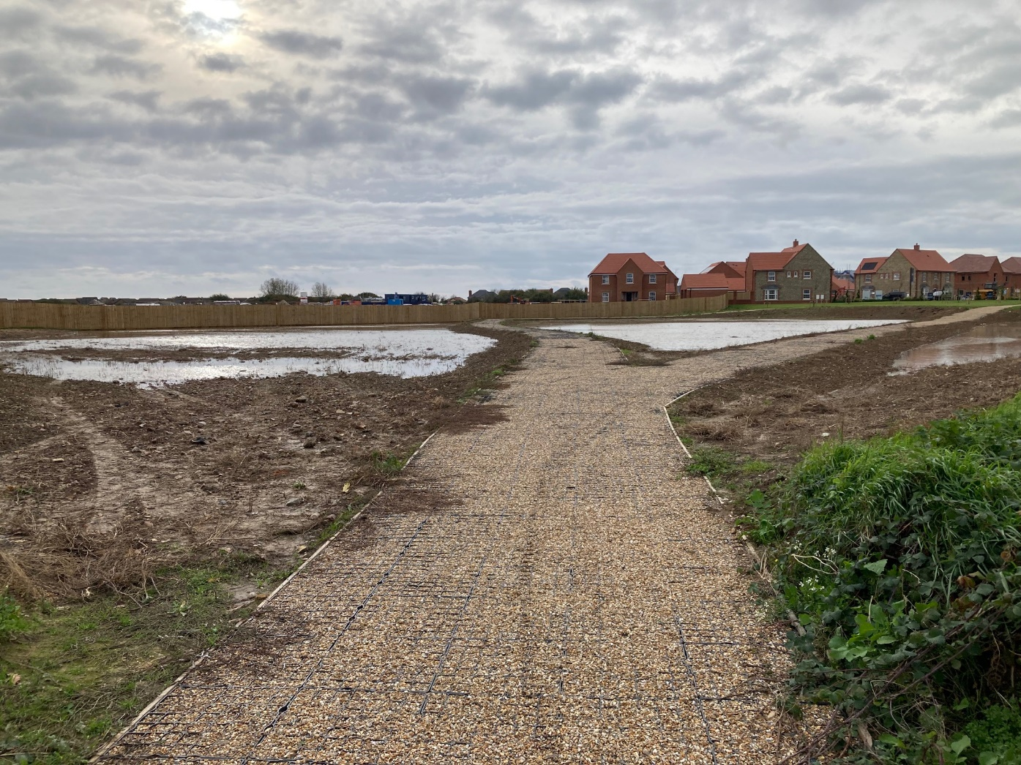
6.Lakeside?

Slide 8
7.Clappers Lane: Fossil Bay
Condition 22 (now 9)- Round 1:
“No dwelling hereby permitted shall be occupied until the off-site foul drainage infrastructure necessary to serve the development is operational and it is confirmed in writing by the sewerage undertaker that sufficient sewage capacity exists within the network to accommodate the development.”
DW Homes applied to discharge this condition – Refused
Earnley PC met with DW Homes Technical Director on 2 occasions

Slide 9
8.Clappers Lane: Fossil Bay
Condition 22 (now 9)- Round 2:
DW Homes then submitted a Section 73 application to vary the condition to allow 50 occupations with RTC underground storage tanks in place- This has also been refused.
To be clear, our objective is to get Southern Water to upgrade the local sewerage infrastructure in order to safeguard existing local residents. We cannot prevent Fossil Bay going ahead, although all marketing has stopped.
EXPECT AN APPEAL!

Slide 10
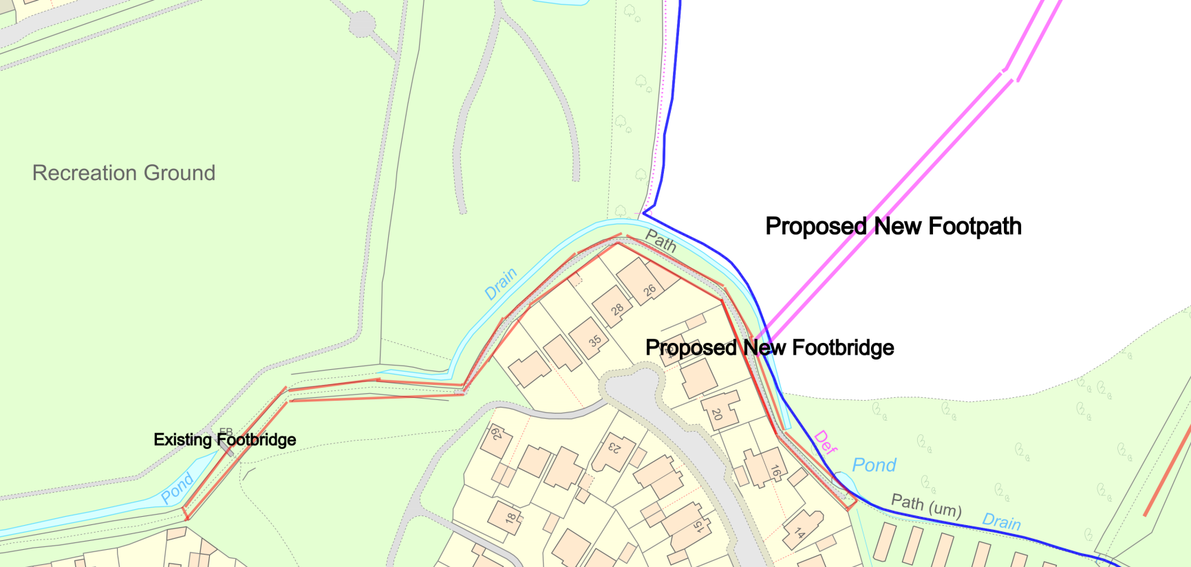
9.New Footpath

Slide 11
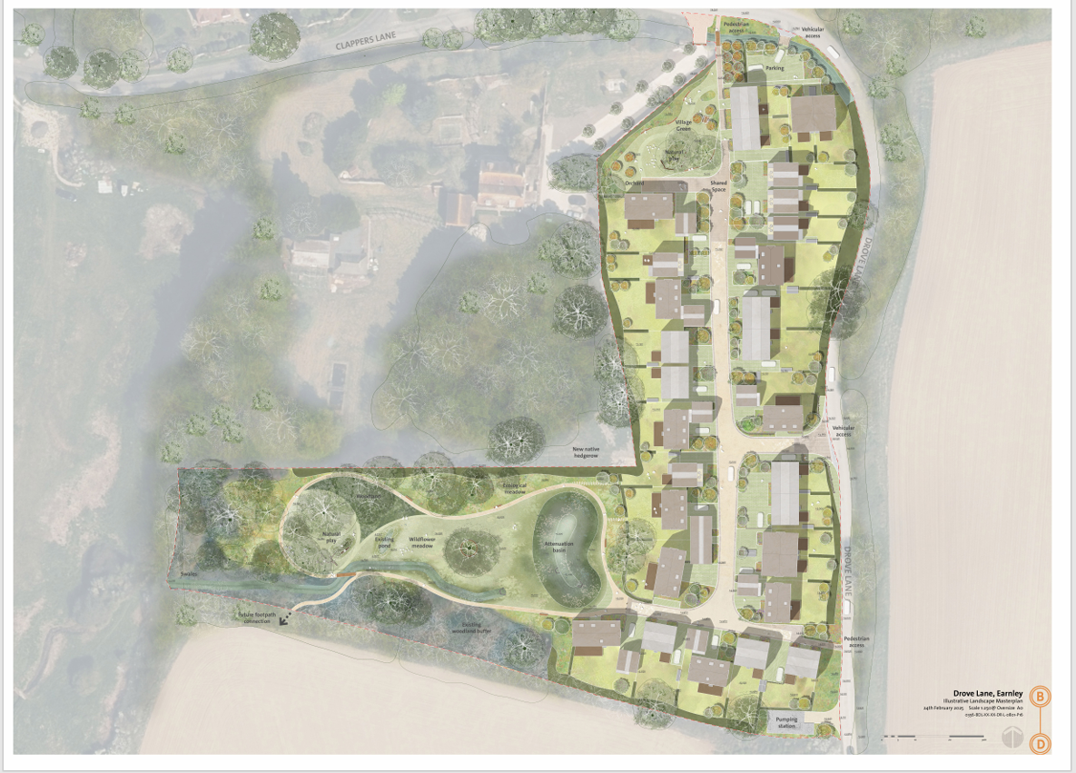
10.The Concourse

Slide 12
11.The Concourse
Condition 20:
Requires the construction of a pavement along the northern side of Clappers Lane. The Parish Council are opposed to this as is the developer: over urbanisation of Clappers Lane. There is now a pavement/footpath off the road through Fossil Bay.
Condition 8:
Sewerage condition has been “discharged”, even though it is on the same network as Fossil Bay.

Slide 13
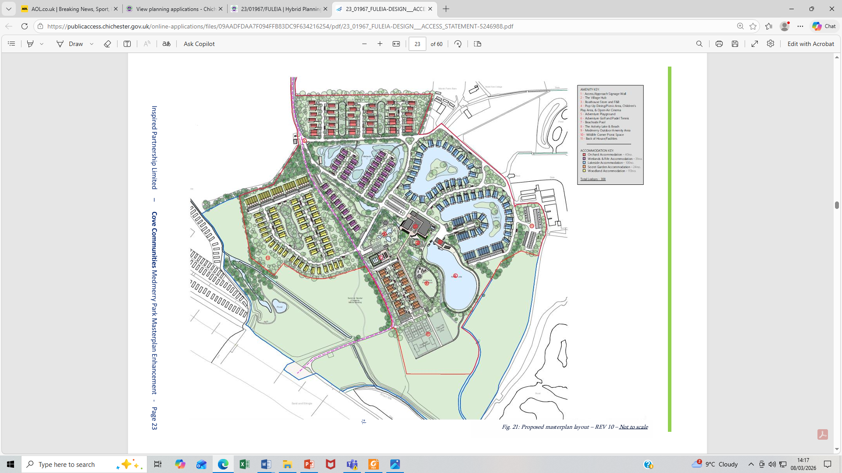
12.Medmerry Park – Illustrative Masterplan

Slide 14
13.Medmerry Park
Still closed after tidal inundation of April 2024
Planning Application still open but nothing since August 2024
The owners – Cove - are buying out the leaseholders and are in dispute with their insurers.

Slide 15
14.Community Infrastructure Levy
We have £113,000. Have to spend within 5 years of receipt.
Spending Plans guided by our 5 year Parish Plan/IBP/Resident Views
Priorities: - Bike Stands – in progress
- Village Gateways – complete
- Footpaths and Cycleways upgrades- in progress
- Biodiversity, inc. tree planting
- Land Purchase - Allotments

Slide 16
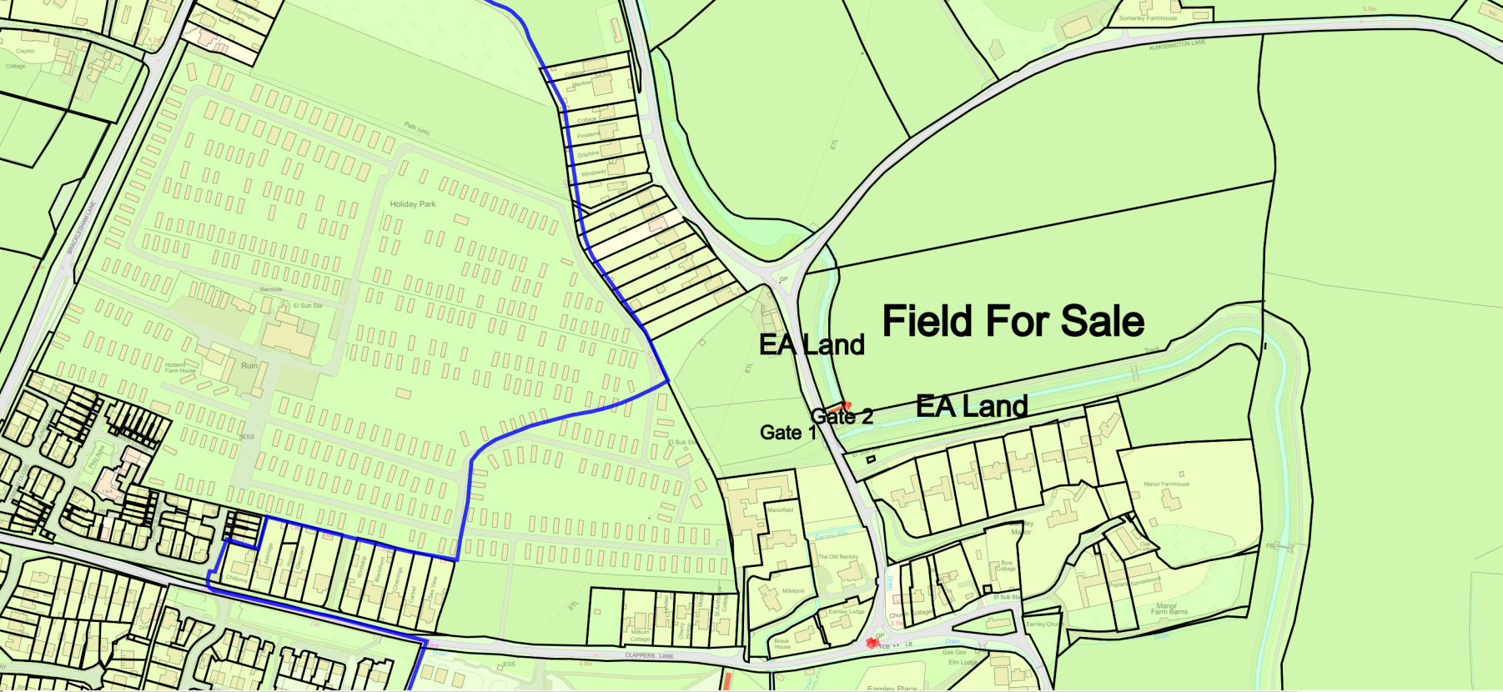
15.Land for Sale – Any Thoughts?

Slide 17
16.Other Achievements & Activities
Meeting with our MP – she listened
Consulted on Local Government Restructuring – 8 authorities to 1 or 2 in Unitary Authorities in West Sussex + new mayoral authority
Removed illegally installed culvert

Slide 18

Any questions or Comments?

